Slide 1
Tempdb configuration
One of the poor performance objects may the tempdb!
The tempdb system database is a global resource that is available to all users (as such it can become very busy)
Its purpose is to hold temporary objects and have certain action performed in the tempdb such as:
    Global or local temporary tables
    Temporary stored procedures
    Table variables
    Cursors
    Results for spools or sorting
    Online index operations
    Multiple Active Result Sets (MARS)
    AFTER triggers.
    Tempdb is re-created every time SQL Server is started
    Backup and restore operations are not allowed on tempdb*
    The point is that the tempdb is a very busy database and must be configured properly for optimal performance

Slide 2
Setting up tempdb
Out of the box we may get into issues of poor performance because of the default settings.
We need to correct these immediately. The following list is something we must do asap:
Default size change for tempdb
Default file numbers change for tempdb
Finding cpu core number for tempdb files

Slide 3
Set the file growth increment
Set the file growth increment to a reasonable size to avoid the tempdb database files from growing by too small a value.
If the file growth is too small, compared to the amount of data that is being written to tempdb, tempdb may have to constantly expand.
This will affect performance. We recommend the following general guidelines for setting the FILEGROWTH increment for tempdb files.
tempdb file size FILEGROWTH increment
0 to 100 MB 10 MB
100 to 200 MB 20 MB
200 MB or more 10%*

Slide 4
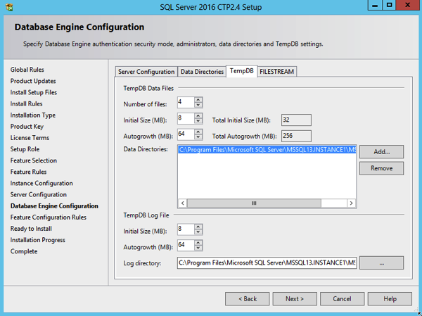

Slide 5
File number rule: Tempdb files based on number of CPU cores (SQL 2016)
When you have less (or equal) than 8 CPU cores, you will get as many TempDb data files as you have CPU cores.
If you have more than 8 CPU cores, you will get 8 TempDb data files out of the box.
--COUNT CPU
SELECT cpu_count,*
FROM sys.dm_os_sys_info
GO

Slide 6
